Slide 1

DROPDOWN & MULTIPLE SELECT

Slide 2
Introduction
DropDown allows the user to choose one value from a list.
Multiple Selection allows the user to choose more than one value from a list.
DropDown is ordinary operation like selecting any other type of element on a webpage.
DropDown & Multiple Select operation can perform by choosing ID, Name, Css & Xpath.
Multiple Selections are not allowed in Dropdown.

Slide 3
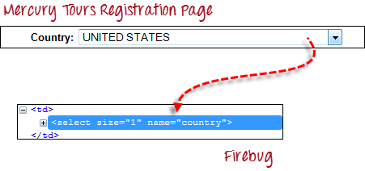
DropDown Box
As an example, go to Mercury Tours' Registration page notice the "Country" drop-down box there.

Slide 4


Import the "Select" package.
Declare the drop-down element as an instance of the Select class.
now "drpCountry" instance using any of the available Select methods.

Slide 5
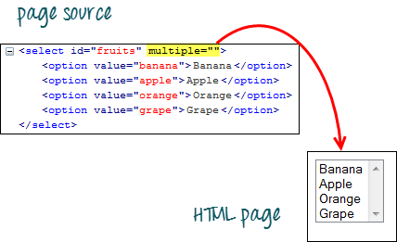
Multiple Select Box
As an example,we will take http://jsbin.com/osebed/2 as the base URL.It contains a drop-down box that allows multiple selections at a time.

Slide 6
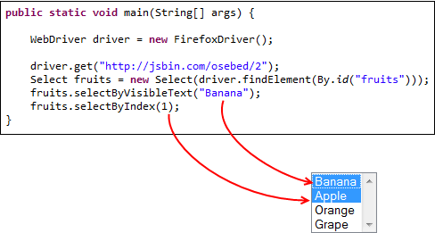
Import the "Select" package.
Select the first two options using the selectByVisibleText() method.

Slide 7

Select Methods
Method
selectByVisibleText() and deselectByVisibleText() Example:
selectByIndex() and deselectByIndex() Example:
isMultiple() Example:
Description
Selects/deselects the option that displays the text matching the parameter.
Parameter: The exactly displayed text of a particular option.
Selects/deselects the option at the given index.
Parameter: the index of the option to be selected.
Returns TRUE if the drop-down element allows multiple selections at a time; FALSE if otherwise.
No parameters needed

Slide 8

selectByValue() and deselectByValue() Example:
deselectAll() Example:
Selects/deselects the option whose "value" attribute matches the specified parameter.
Parameter: value of the "value" attribute
Remember that not all drop-down options have the same text and "value", like in the example below.
Clears all selected entries. This is only valid when the drop-down element supports multiple selections.
No parameters needed

Slide 9
DropDown Box
Element | Command | Description
Drop-Down Box | selectByVisibleText()/ deselectByVisibleText() | selects/deselects an option by its displayed text
 | selectByValue()/ deselectByValue() | selects/deselects an option by the value of its "value" attribute
 | selectByIndex()/ deselectByIndex() | selects/deselects an option by its index
 | isMultiple() | returns TRUE if the drop-down element allows multiple selection at a time; FALSE if otherwise
 | deselectAll() | deselects all previously selected options

Slide 10
Covered Till Now
Find the “DropDown Box" field using the Name locator.
Find the “Multiple Select Box" field using the id locator.
Describe Different Select methods.

Slide 11
Thanks

